Slide 1

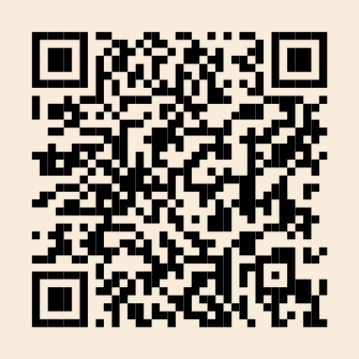
Handelshøyskolen
UiA Alumni

Slide 2

Nettverk
Kunnskap
Karriere

Slide 3
UiA Alumni
School of Business and Law

Slide 4
Network
Knowledge
Career

